Slide 1

ABC PHARMACEUTICAL SALES ANALYSIS REPORT

Slide 2
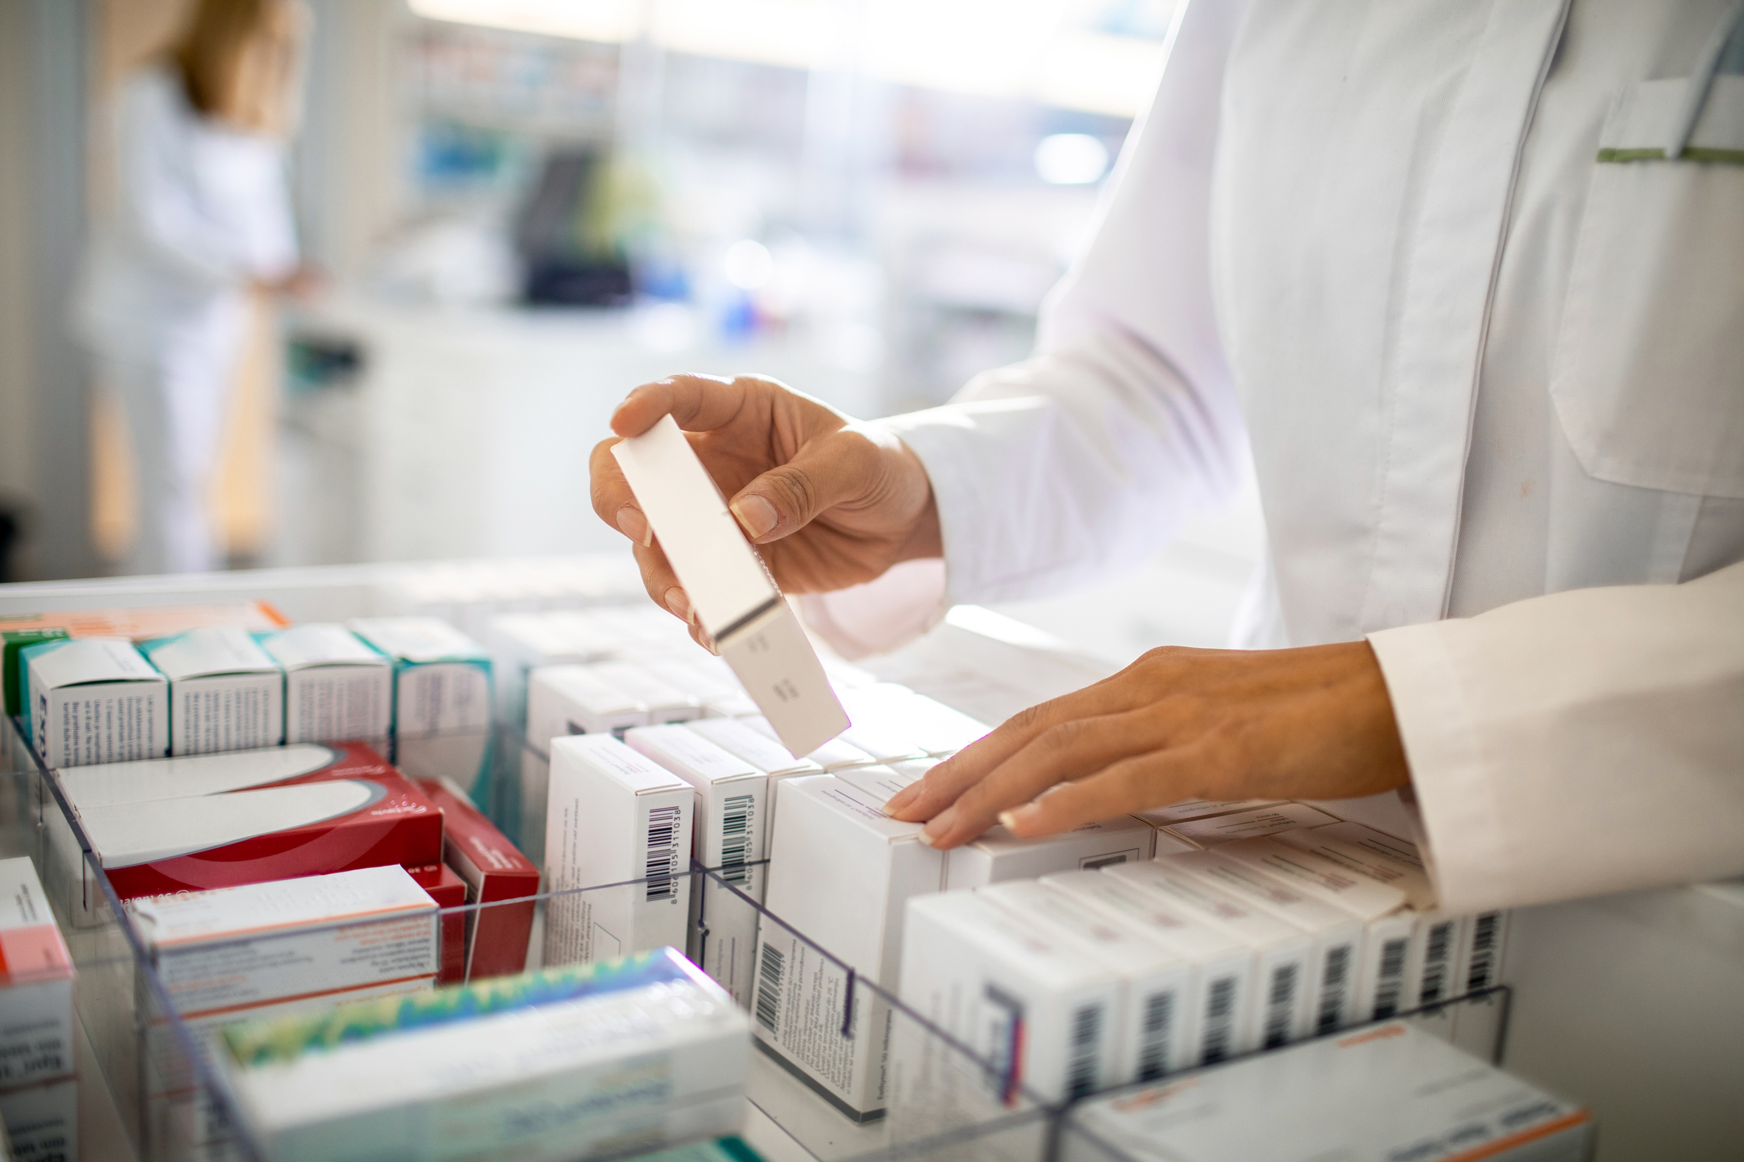
AGENDA
INTRODUCTION
DATA PREPARATION
ANALYSIS
KEY TAKEAWAYS
RECOMMENDATION

Slide 3
DATA PREPARATION
The data was provided by 3Signet and the tools used for this analysis are:
Excel
Python
Power BI
DB Browser (SQLite)
Data cleaning processes which includes removal of duplicates in the dataset, categorizing the columns for easier analysis was done on the dataset.

Slide 4
3 Main analysis
Sales performance variation among different customer channels
Sales variation by location in reference to population density and infrastructure.
Sales based on price and quantity

Slide 5
ANALYSIS
The dataset contained over 245 thousand sales encounters, and it has a total revenue of 12billion(bn).
Between 2017-2020, the year with the highest sales is 2018 (3.5bn) and the lowest sales occurred in 2020 (2bn). The month with highest sales collectively is November (1.1bn) and for lowest sales, it is January (67m).
The top 3 product class for each year by revenue are Analgesics (2.3bn), Antiseptics (2.2bn) and mood stabilizers (2bn).
Germany accounted for 11bn (94%) of the revenue while Poland had only 680million (6%) in revenue.
For Poland, sales was only recorded in 2018 and the highest class of drugs sold is antiseptics (6m) and mood stabilizers (2.6m) in November.

Slide 6

ANALYSIS

Slide 7
ANALYSIS

Slide 8
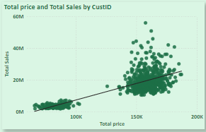
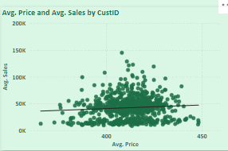
Statistical ANALYSIS
This shows a positive correlation between price of products and the sales, either as sum of values or average values.

Slide 9
ANALYSIS ON PRODUCT, LOCATION & MANAGER
Manager | Product Class | Top Location(revenue) | Rural/Urban
Brittany Bold | Analgesics | Altenburg (31m) | Urban
Brittany Bold | Antiseptics | Ludwigshafen (21m) | Urban
Brittany Bold | Mood stabilizers | Cuxhaven (33m) | Semi-Urban
Brittany Bold | Antipyretics | Bottrop (31m) | Urban
Brittany Bold | Antibiotics | Springe (20m) | Rural
Alisha Codwell | Antimalaria | Castrop-Rauxel (31m) | Urban

Slide 10
KEY TAKEAWAYS
Sales depends on location as it plays a huge role on the class of drugs largely purchased in that vicinity.
Channel of distribution has an impact on revenue as analysis has shown Pharmacy has the highest revenue as compared to Hospital. The same way government hospitals generate higher revenue as compared to private (population is higher in government hospitals).
Also, 94% of revenue is from Germany with top cities being Altenburg, Cuxhaven and Freidberg.
The drug with the highest revenue is Sumanazole (113m) and the least is Ampheslox (2.6m).

Slide 11
RECOMMENDATION
Leverage the data gotten on classes of drugs based on location during the distribution process. Antiseptics are highly purchased in Ludwigshafen as compared to Bottrop. Also, analgesics and antiseptics are common in urban areas. Distribution should be prioritized to these fast-moving locations as compared to the slow-moving ones.
Retail pharmacies and public hospitals should be priority during distribution since majority of revenue comes from both locations.
Brittany Bold and her team members accounts for the bulk of revenue made, incentives can be given to motivate other managers and their team members to do better in their location.

Slide 12

THANK YOU
Salamah Alawiye
salamahalawiye@gmail.com

